Slide 1


Report Card Academic Achievement Indicators
1 2 3 4
What does this mean?

Slide 2
Purpose of a 1-4 Point Scale
Clarity: clear framework for evaluating student performance
Feedback: offers feedback on strengths and areas of improvement
Standardization: consistent method of assessing learning across schools

Slide 3
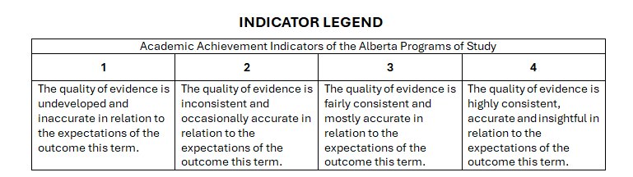
Indicator Legend
-below expectations -difficulty applying concepts -requires high levels of support | --approaching expectations -requires some support | -basic understanding of expectations -may require minimal support | -complete understanding -is able to apply and transfer understanding indepedently

Slide 4
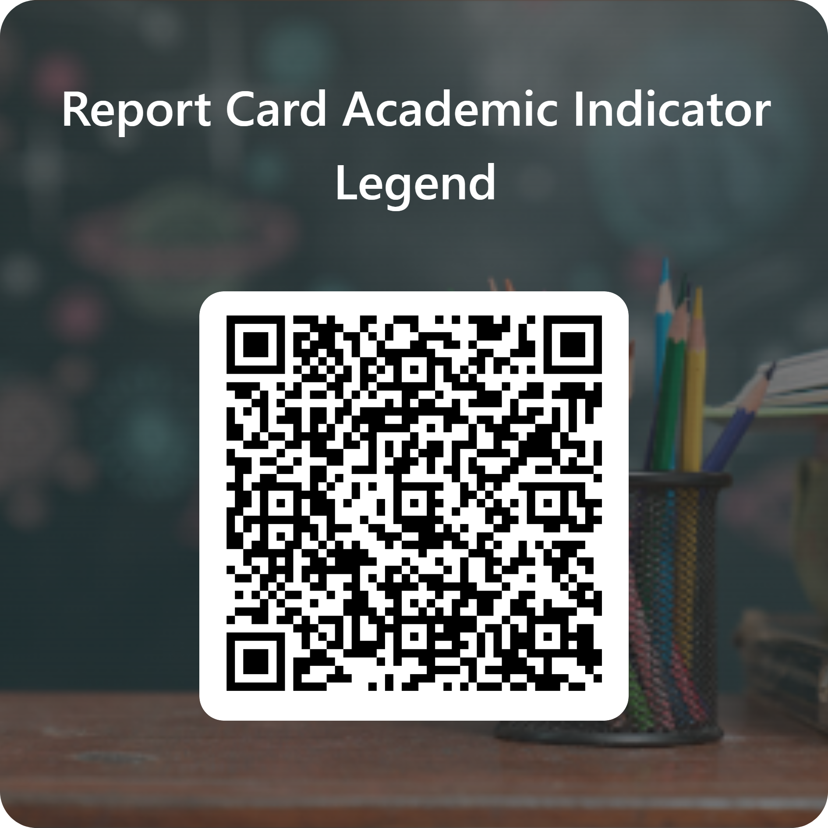
Feedback

